Slide 1
Operators, Boolean Expressions, and Comments

Slide 2
Comments
A comment is a line of code that doesn’t get run
You use comments to document your code - describe what your code is doing in words. Comments are a type of documentation.
Comments are important if you’re doing individual work to remind you what your own code does
They’re especially important if you’re doing team work, to explain to your team what the code does.
In most development jobs, you’ll be working on a team, so you need to document your code with good comments.

Slide 3
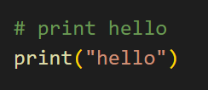

Single-Line Comments
In Python, you start a single line comment with #
Everything after the # symbol is ignored when you run your code, so you can put whatever you want after it
You can start a line with #, or put the comment on the same line as a line of code
Standard single-line comment
In-line comment

Slide 4
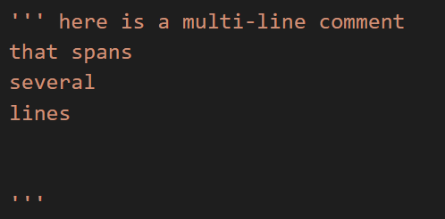
Multi-Line Comments
You can also write a comment that spans multiple lines.
In Python, you open the comment with three quotes, and close it with three quotes. Everything between the quotes is a comment.
Just like for strings, they can be single or double quotes.
Multi-line comments can be as many lines as you want, or even just one line.

Slide 5
PEP 8 Comments
https://www.python.org/dev/peps/pep-0008/#comments

Slide 6
Example
Add comments to the perimeter of a rectangle example from last class.

Slide 7
Exercise
Add comments to the Fahrenheit to Celsius conversion exercise from last class.

Slide 8
Console
The console is like an active python coding environment.
In here, we can type out code and run it line by line.
There are some things that can’t be done in the console.
We also can not save our code when working in the console.
We will not really be using the console in this class.

Slide 9
Arithmetic Operators Review
+ Addition
- Subtraction
* Multiplication
/ Division
** Exponents
// Integer Division
% Modulo/mod/remainder
Keep in mind
Order of operations: PEMDAS
Parentheses
Exponents
Multiplication/Division and Mod, for Python
Addition/Subtraction
Use parentheses for clarification if need

Slide 10
Shortcut Operators
For each arithmetic operator, you can use shortcut operators if you’re adding to an existing value.
For example, if you have a variable named num and you want to add num to it, that would be num = num + 5
Using shortcut operators, we can shorten this to num += 5
These lines do the exact same thing: They add 5 to the existing value of num, and then store it back in num.

Slide 11
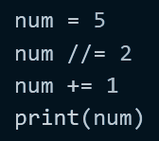
Exercise
What is the output of this code?

Slide 12
Exercise
Change your code that converts Fahrenheit to Celsius to only use shortcut operators.

Slide 13
Boolean Review
A boolean is a data type in Python like ints, floats, or strings. In Python, booleans are called bool.
A boolean must be either True or False.
Booleans have a lot of uses that we will see later on in this course. You usually use booleans if there are two possible conditions, like a yes/no question.

Slide 14
Boolean Operators
< Less Than
<= Less Than or Equal To
> Greater Than
>= Greater Than or Equal To
== Equals
!= Not Equals
and Both True
or One True
not Opposite
is Are they the same Object?
in Inside of
Using any of these operators on two values results in a boolean - the result is either True or False.

Slide 15
Example
Go back to the perimeter of a rectangle example and print whether the length is larger than the width.

Slide 16
Exercise
Go back to the Fahrenheit to Celsius conversion exercise, and print whether the Fahrenheit is greater than the Celsius.

Slide 17
Converting Data to Booleans
You can’t directly cast data to a boolean like with other data types
The bool() function evaluates whether the object exists or not. So it will always return True, unless you pass in an empty object, False, 0, or None
If you want to cast a string to a boolean, you have two options:
You can manually check if the string == "True" or == "False", in which case set it equal to True or False. (More on this when we learn about conditionals)
You can cast it to a boolean using eval(), the evaluate function
eval("True") returns True
eval("False") returns False
More on eval(): https://realpython.com/python-eval-function/

